Slide 1
SCREENSHOT OF SQL QURIES

Slide 2
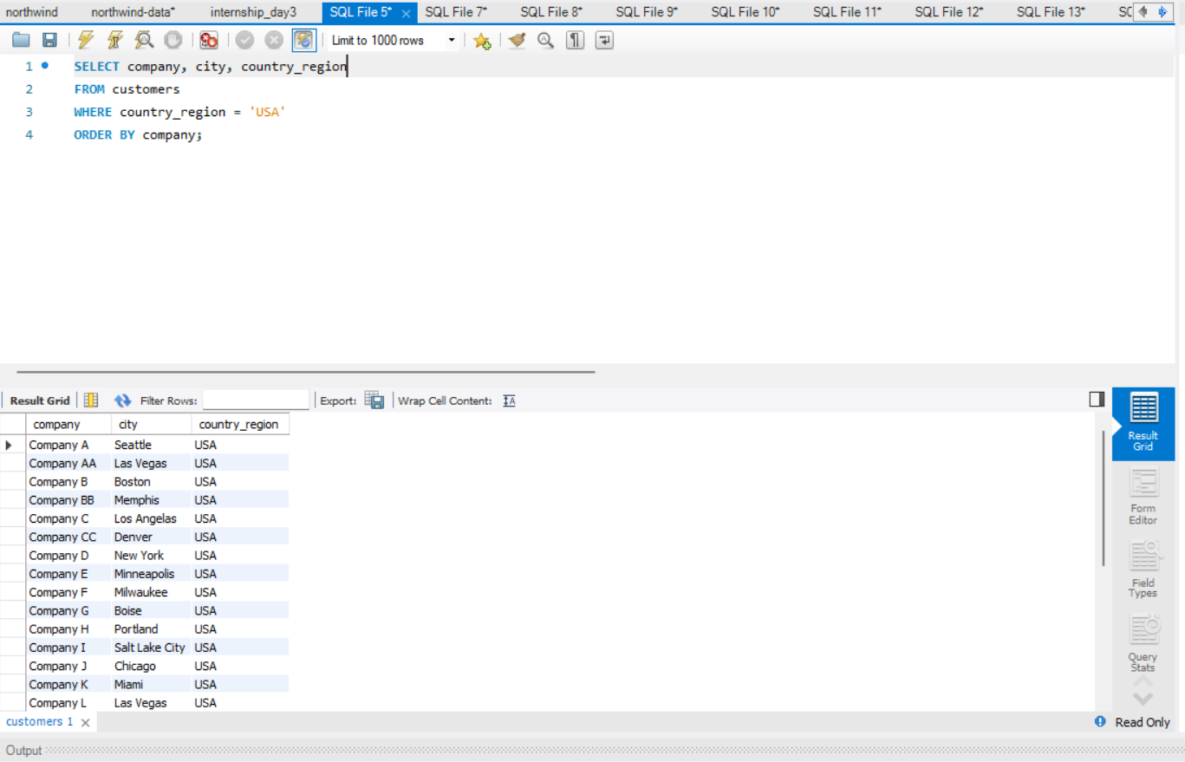
List all customers from 'USA' and sort by company name

Slide 3
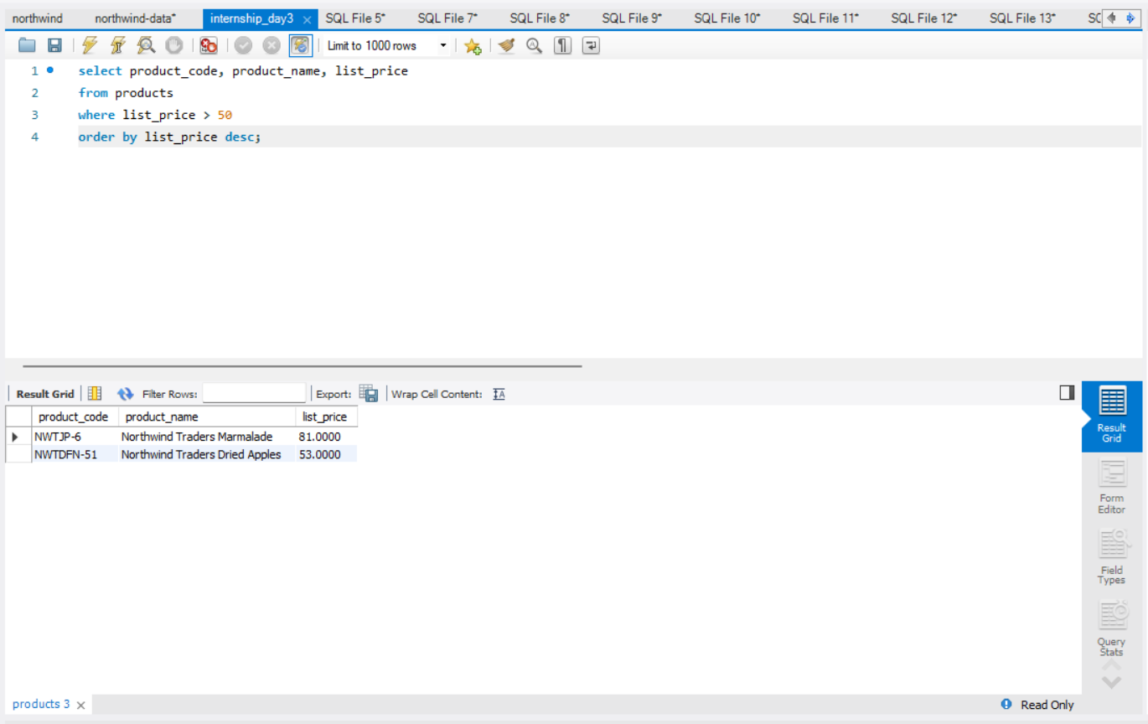
Get all products with unit price > 50, sorted by price descending

Slide 4
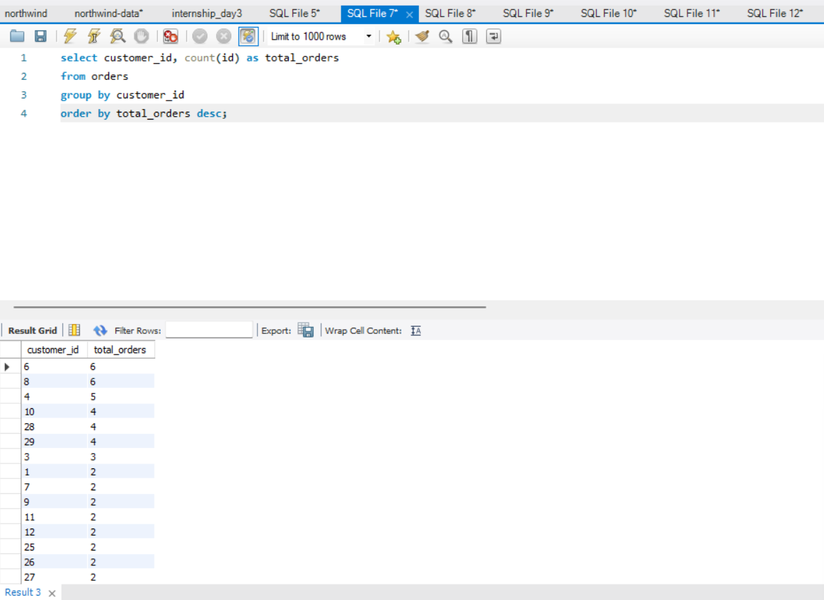
Total number of orders per customer

Slide 5
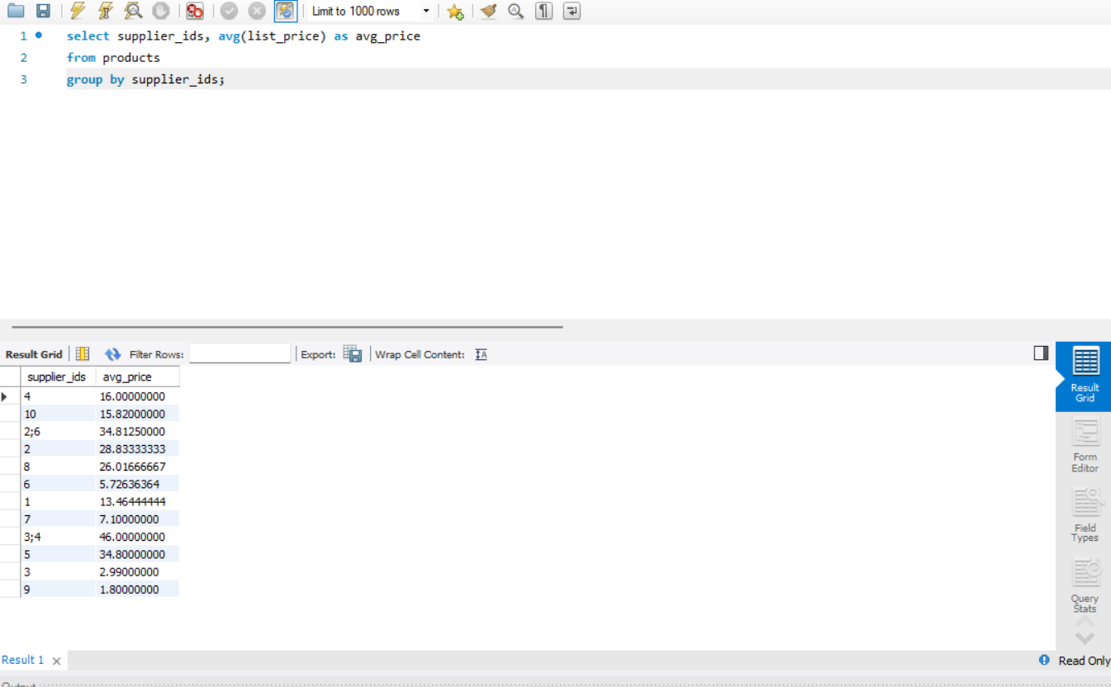
Average List price per supplier

Slide 6
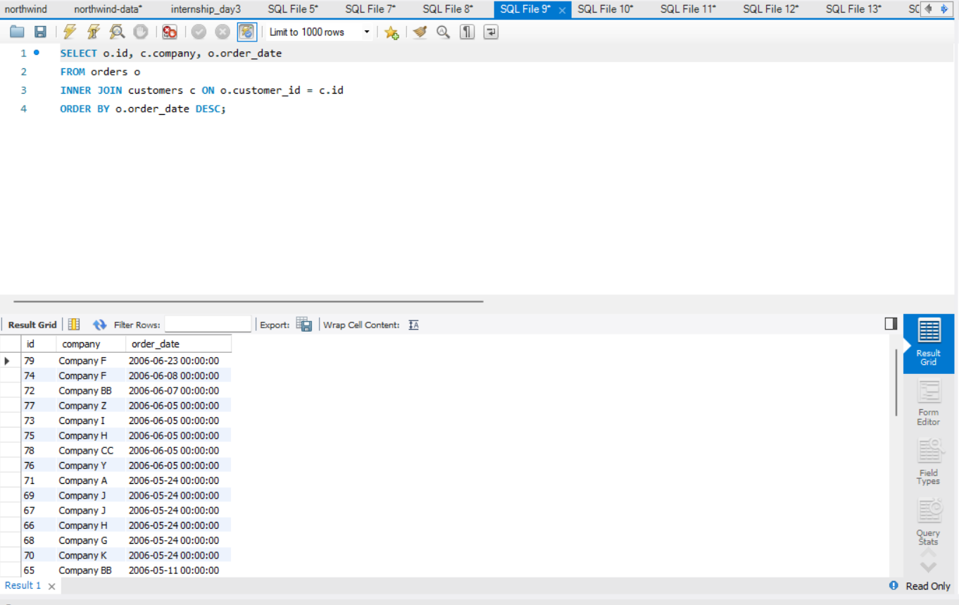
List of orders with customer names (INNER JOIN)

Slide 7
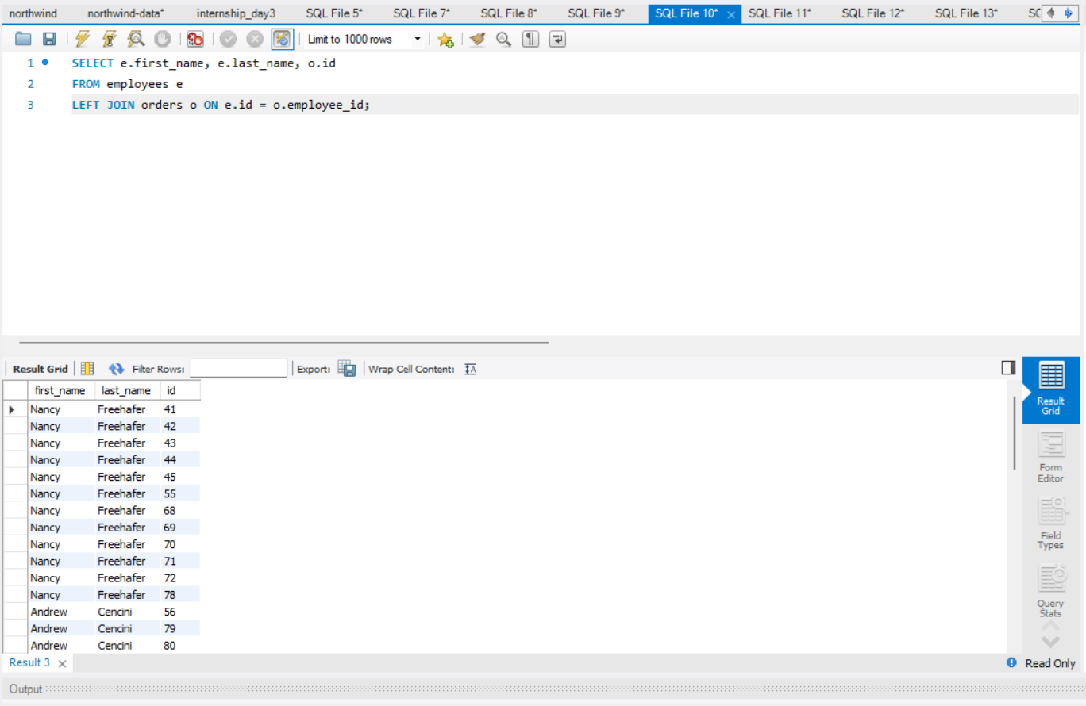
LEFT JOIN: Employees and their orders (even if no orders)

Slide 8
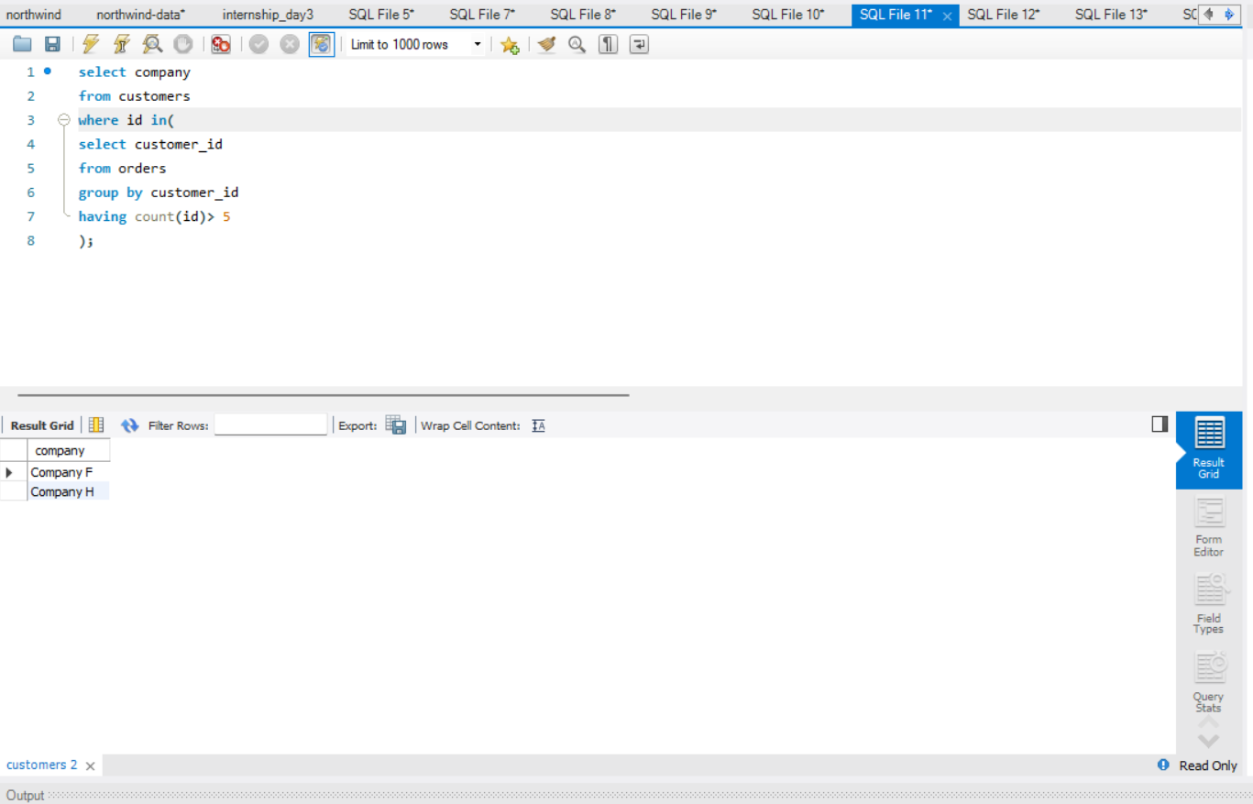
Customers who have placed more than 5 orders

Slide 9
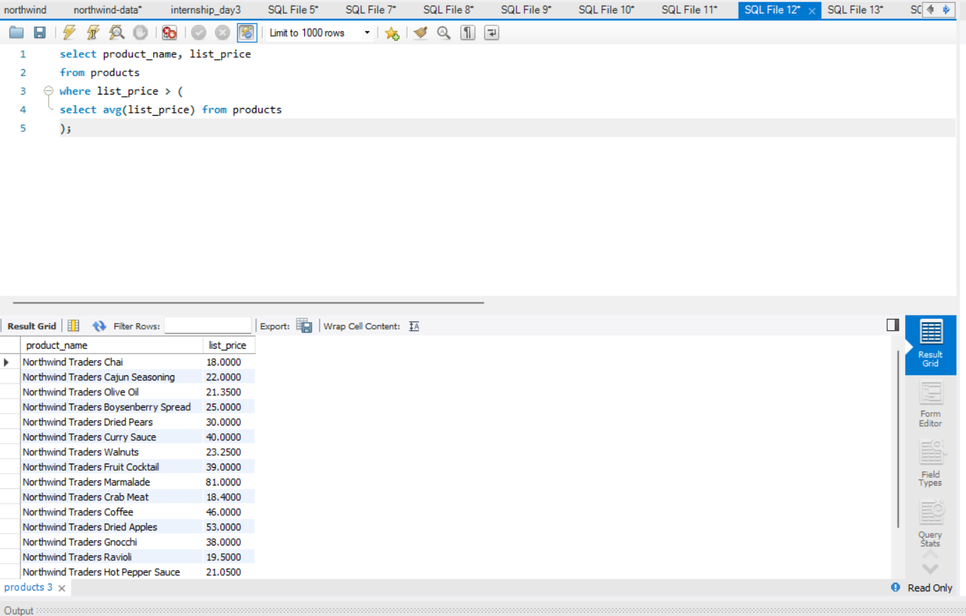
Products with price greater than the average price

Slide 10
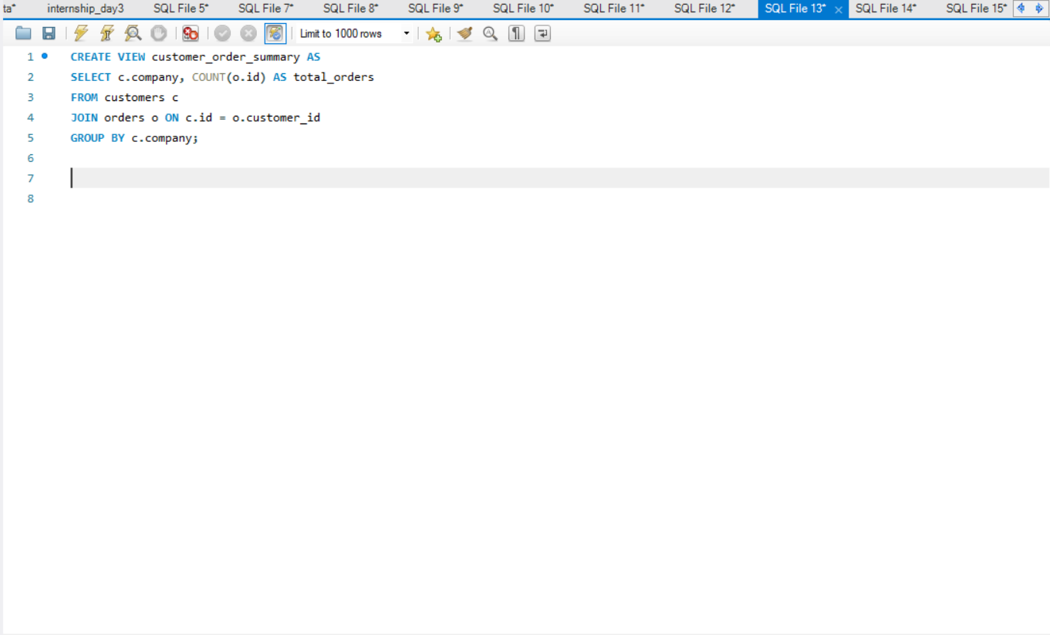
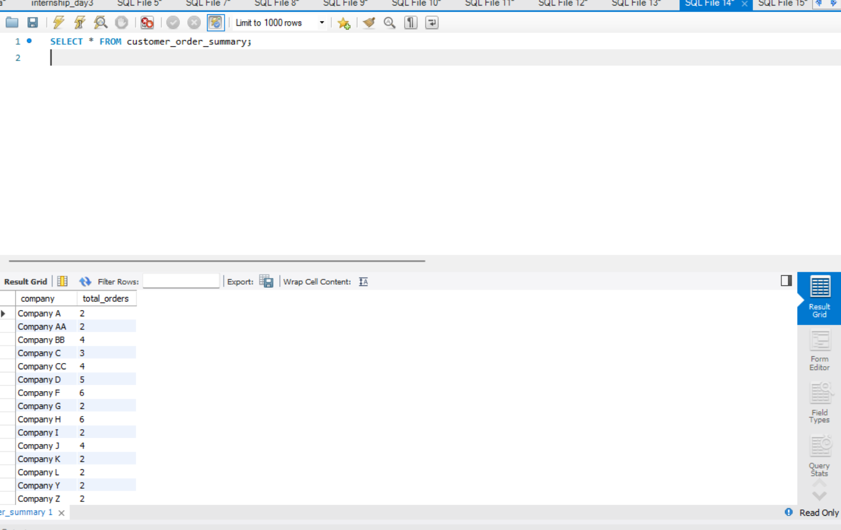
View for customer order summary

Slide 11
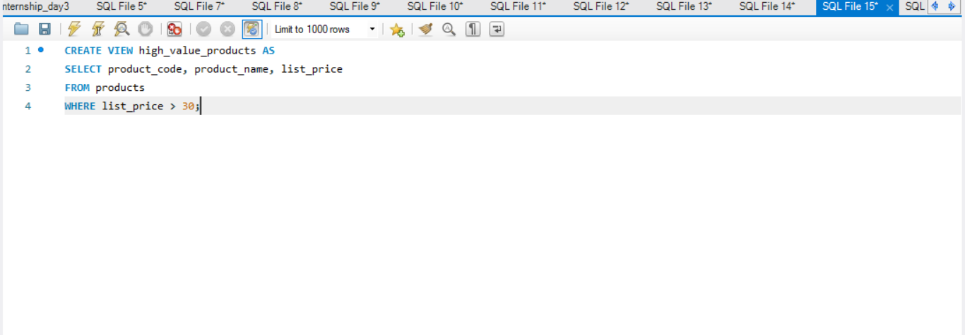
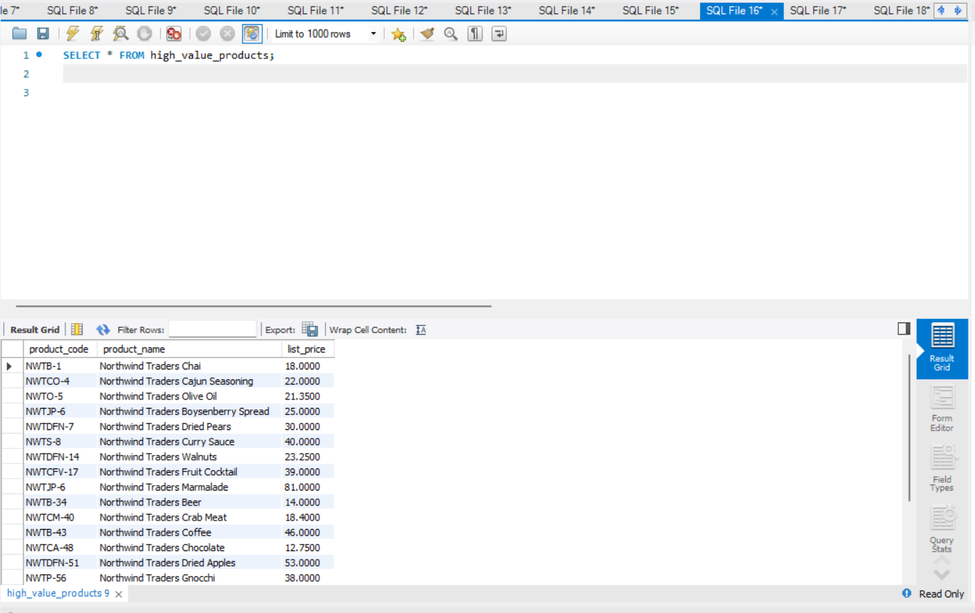
View of high-value products (price > 100)

Slide 12
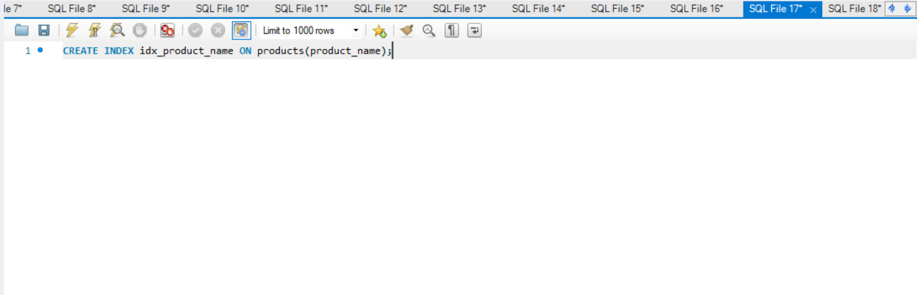
Index on product name (if you often search/filter by name)

Slide 13
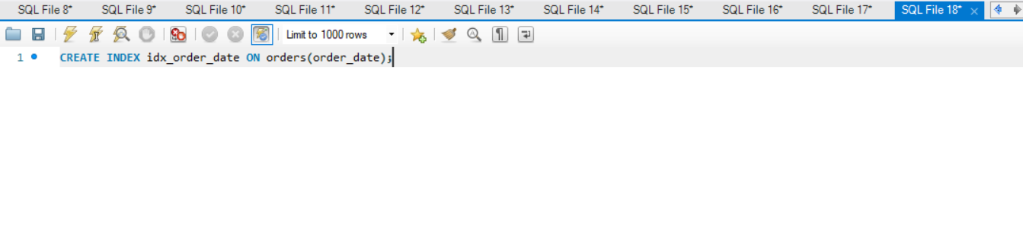
Index on order_date (for faster filtering)

